Slide 1
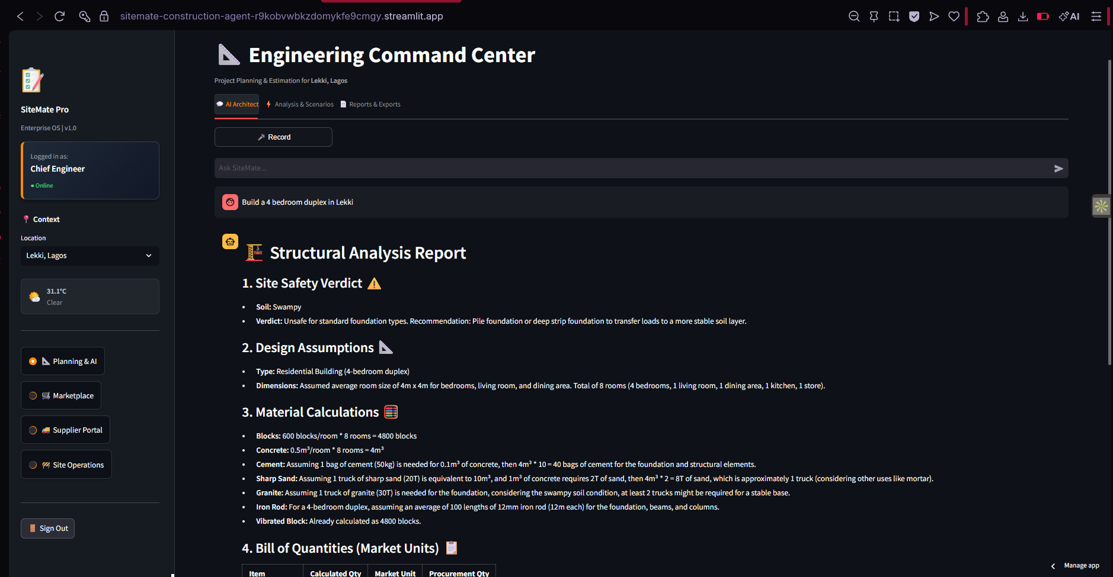
SiteMate Pro
The Enterprise Operating System for African Construction
From Blueprint to Bank Alert — Unified.
Built for Algolia Agent Studio Challenge 2026
Presenter: Mubarak Adisa (Chief Engineer )

Slide 2
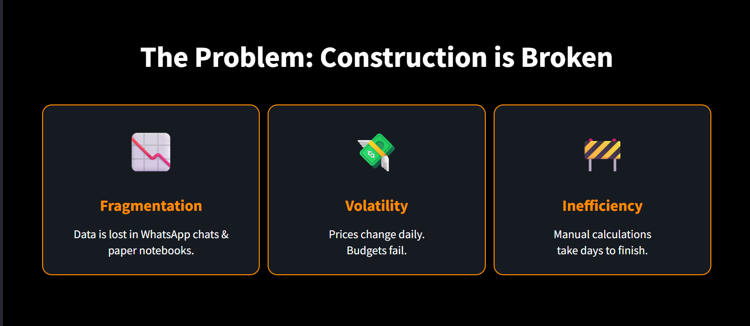
The Problem

Slide 3
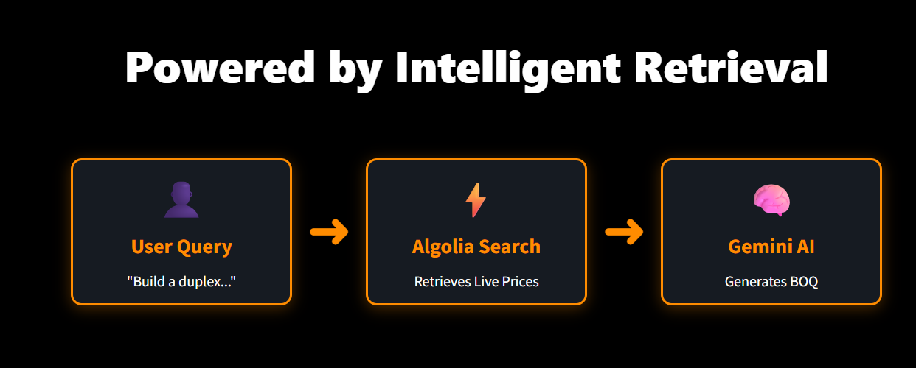
The Solution & Tech Stack
Username: admin
Password: admin123
GitHub link:
https://github.com/AdMub/Sitemate-Construction-Agent
🚀 Enter Command Center

